Slide 1
Pharmaceutical stores sale prediction using Time series
(Project 6)
Rossmann Sales Forecasting
Prepared by Bhanwar Singh

Slide 2
Project Overview
Objective:
Predict store sales for next 6 weeks
using random forest and time series.
Methodology
Data Collection
EDA & Cleaning
Feature Engineering
Model Training
Streamlit and Deployment

Slide 3
Notebook 1 — EDA
Data cleaning
Missing value handling
Date features
Created processed datasets
Key Insights from EDA
Promotions strongly uplift sales
Holiday periods drive spikes
Competition distance matters
Clear weekly & seasonal patterns

Slide 4
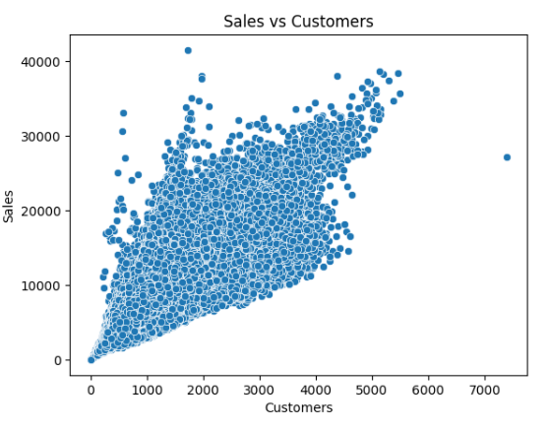

Slide 5
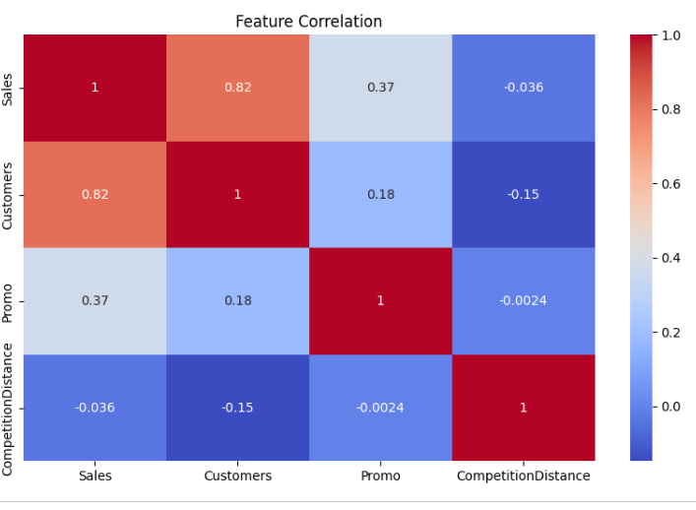

Slide 6
Notebook 2 — Random Forest
Feature-based ML model
Handled non-linear patterns
Best MAE & RMSE
Chosen final model

Slide 7
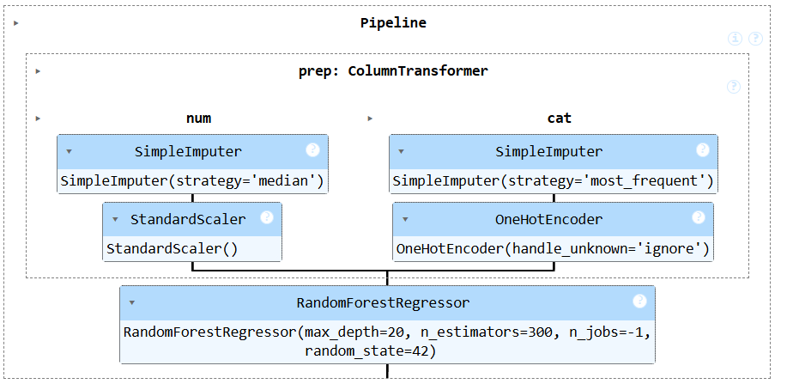


Slide 8
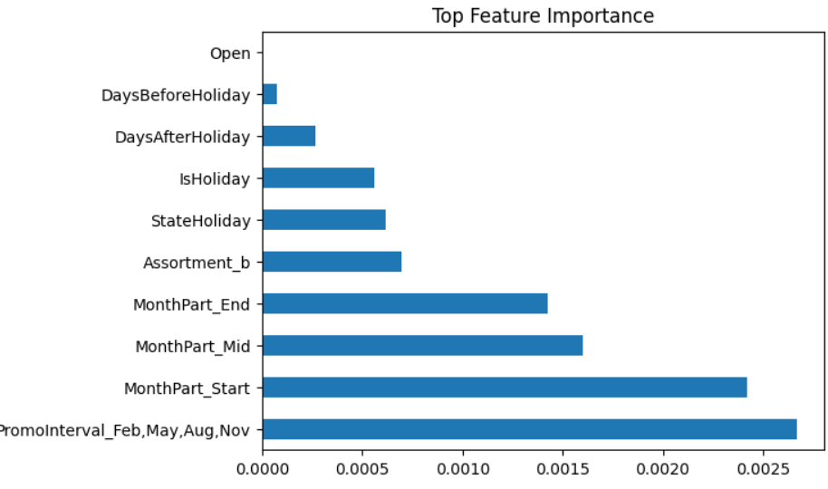

Slide 9
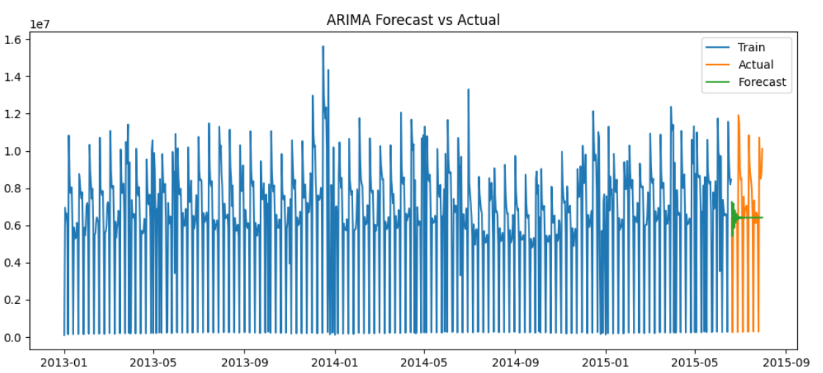
Notebook 3 — ARIMA
Time series forecasting
ADF stationarity test
Modeled trend & seasonality

Slide 10
Notebook 4 — LSTM
Deep learning model
Sequence learning
Compared with RF & ARIMA

Slide 11
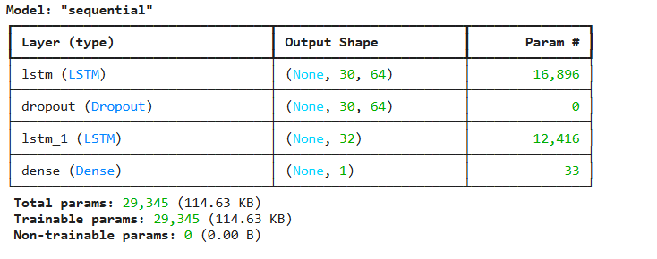
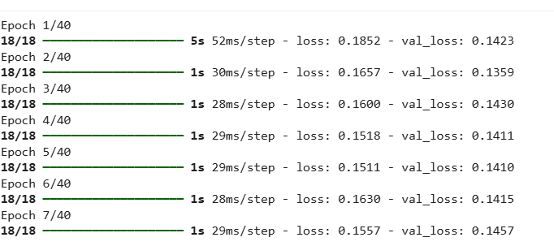

Slide 12
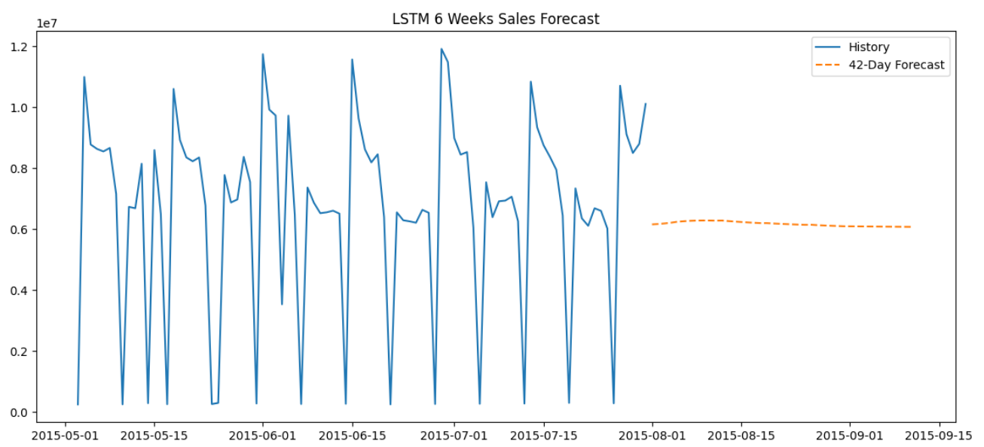

Slide 13
Models Explored
Random Forest (ML)
ARIMA (Time Series)
LSTM (Deep Learning)
Compared using RMSE & MAE
Why Random Forest used
Lowest validation error (RMSE)
Captures non‑linear effects
Uses rich business features
Stable & interpretable

Slide 14
Model Performance

Slide 15
Deployment Architecture Diagram
User → Streamlit UI
Streamlit → ML Model
Model → Predictions
Predictions → Visualization & Download
Charts & CSV Export

Slide 16
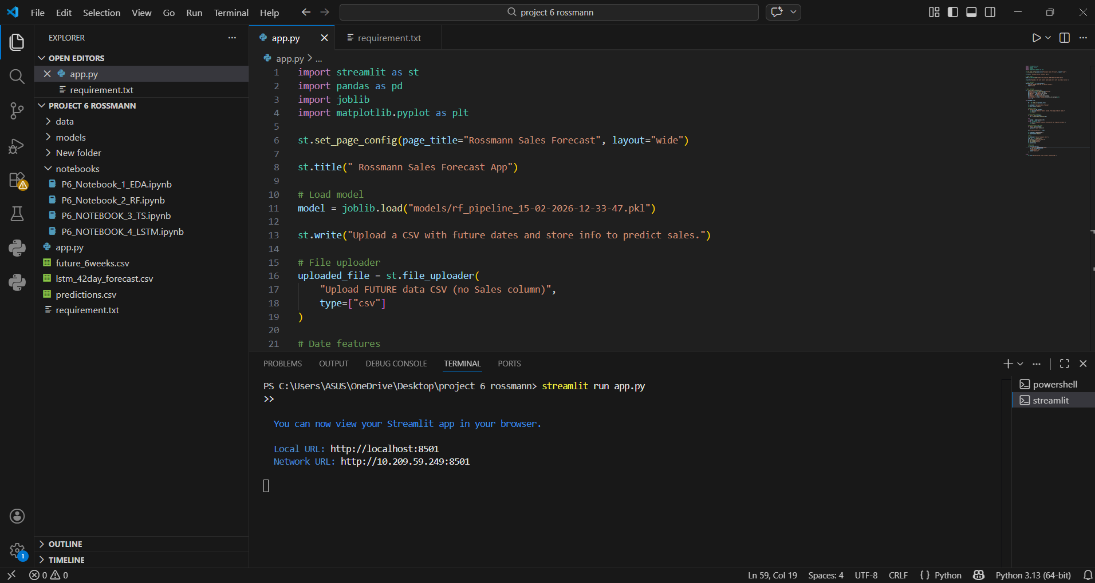
Streamlit App (Screenshot)

Slide 17
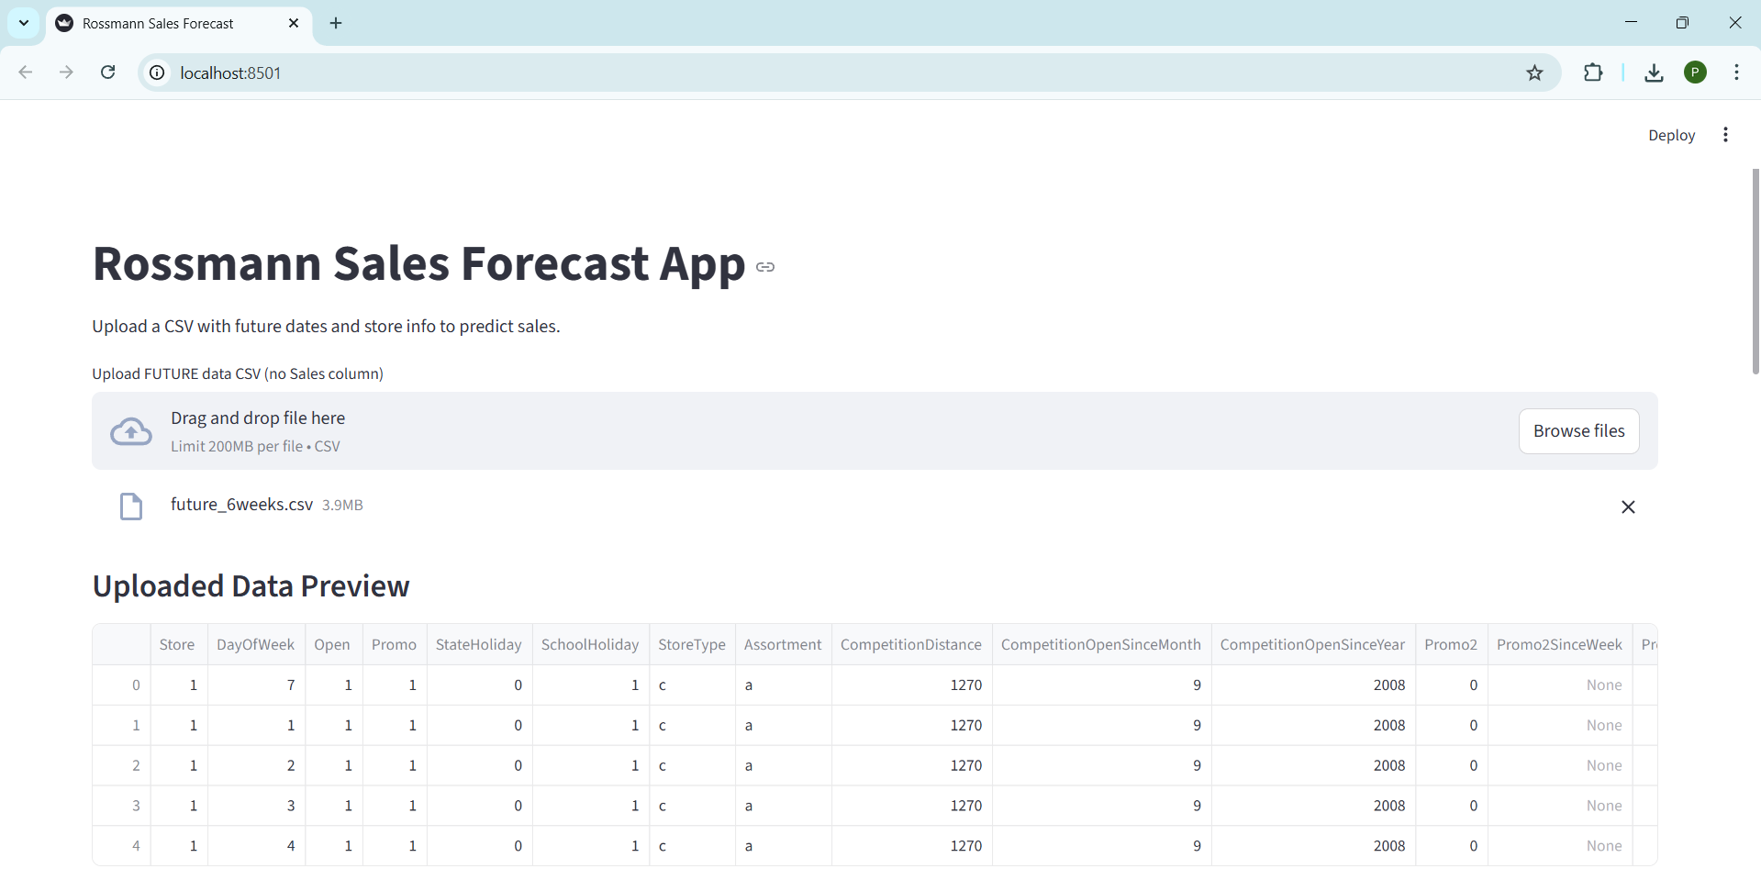

Slide 18
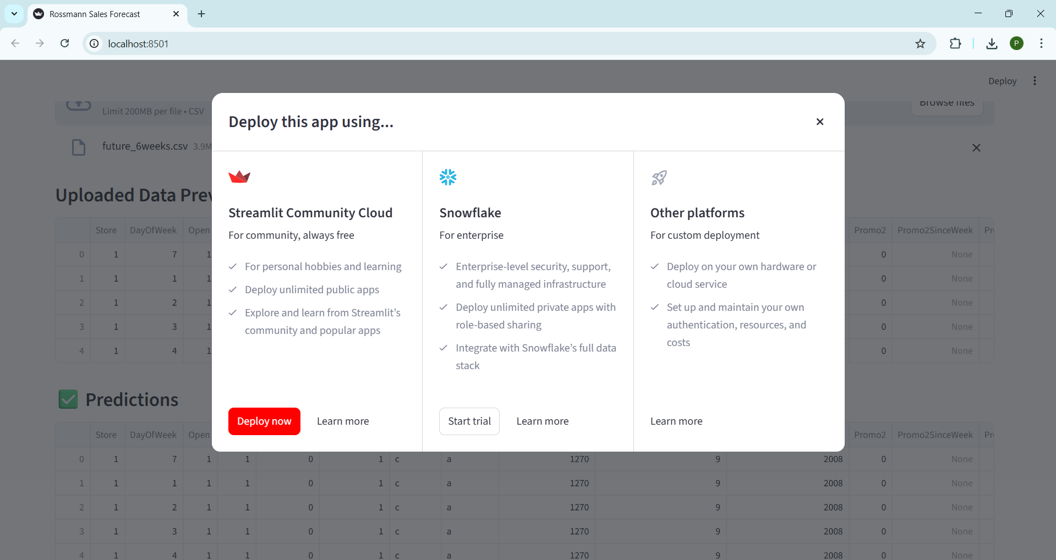
CSV upload
Forecast chart
Download predictions

Slide 19
Conclusion
Sales exhibit strong temporal and non-linear patterns.
LSTM captures sequential dependencies better than ARIMA.
Random Forest remains competitive due to external features.
Sales show strong weekly seasonality.
Series was non-stationary; differencing fixed it.
ARIMA performed better than naive baseline.
Model captures trend but struggles with sudden spikes.
This justifies moving to ML/LSTM for better performance

Slide 20
THANK YOU

